Slide 1
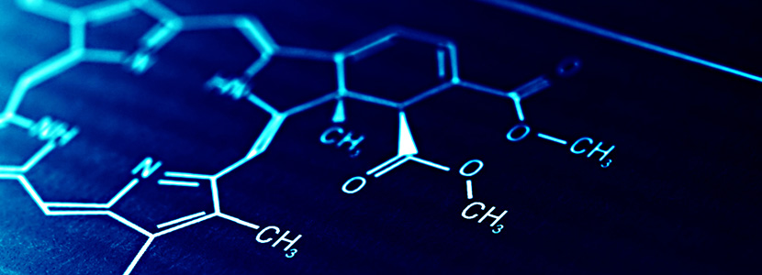
POLYMERS
→PRESENTAION BY
1)RAHUL GM
2)RAJENDRA
3)RAKSHITHA

Slide 2
Polymers - Introduction
Polymers are macromolecules made of repeating units (monomers).
They are widely used in daily life and industries.
Examples include plastics, rubber, and fibers.
They can be natural or synthetic.

Slide 3
Definition of Polymers
A polymer is a large molecule formed by repeated bonding of monomers.
These chains can be linear, branched, or cross-linked.
They have high molecular weight.
Example: Polyethylene from ethene.

Slide 4
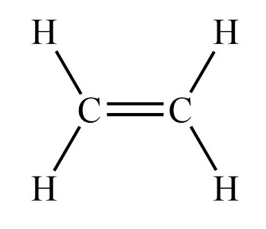
Monomers
Monomers are small reactive molecules.
They join together through chemical reactions.
Can be identical or different molecules.
Examples: Ethene, Propene, Vinyl chloride.

Slide 5
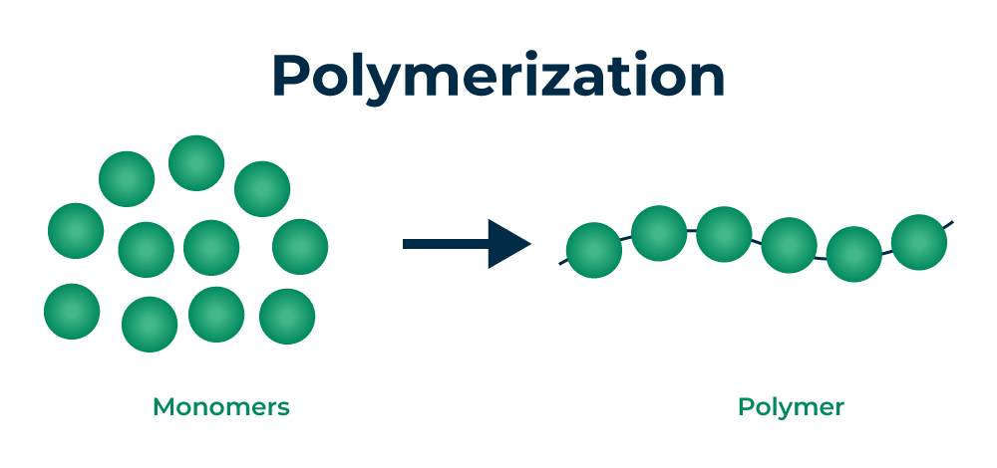
Polymerization
Process of converting monomers into polymers.
Involves chemical bonding between molecules.
Requires initiators, catalysts, or heat.
Two main types: Addition and Condensation.

Slide 6
Addition Polymerization
Monomers contain double bonds.
No by-products are formed.
Chain reaction mechanism.
Example: Polyethylene, PVC.

Slide 7
Condensation Polymerization
Monomers contain functional groups like -OH, -COOH.
Small molecules like water or HCl are released.
Step-growth mechanism.
Example: Nylon, Polyester.

Slide 8
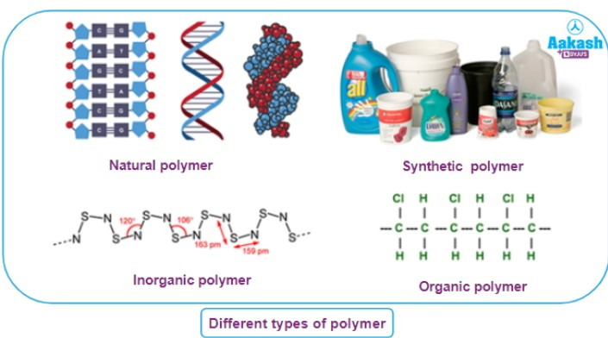
Classification Based on Source
Natural polymers: Found in nature (rubber, proteins, DNA).
Semi-synthetic: Modified natural polymers.
Synthetic polymers: Man-made (plastics, nylon).

Slide 9
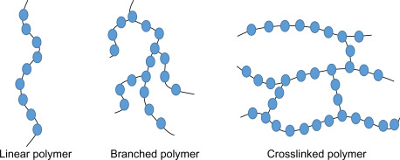
Classification Based on Structure
Linear polymers: Straight chains (HDPE).
Branched polymers: Side chains present (LDPE).
Cross-linked: Network structure (Bakelite).

Slide 10
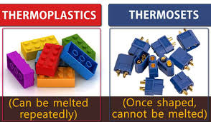
Classification Based on Thermal Behavior
Thermoplastics: Can be reshaped on heating.
Examples: PVC, Polystyrene.
Thermosetting: Cannot be reshaped after heating.
Examples: Bakelite, Epoxy.

Slide 11
Properties of Polymers
Lightweight and strong.
Flexible and durable.
Resistant to chemicals and corrosion.
Good electrical and thermal insulators.

Slide 12
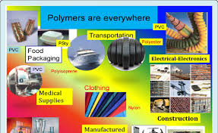
Applications of Polymers
Used in packaging materials (plastic bottles, bags).
Textiles (nylon, polyester).
Automobile parts and tyres.
Medical uses (syringes, implants).

Slide 13
Examples of Polymers
Polyethylene (PE): Packaging.
PVC: Pipes and cables.
Nylon: Fibers and textiles.
Bakelite: Electrical switches.

Slide 14
Advantages of Polymers
Low cost and easily available.
Highly versatile in applications.
Lightweight and strong.
Resistant to water and chemicals.

Slide 15
Disadvantages of Polymers
Non-biodegradable causing pollution.
Difficult to recycle some plastics.
Release toxic gases on burning.
Environmental impact is high.

Slide 16
Conclusion
Polymers play a vital role in modern life.
Used in almost every industry.
Need proper disposal and recycling.
Future focus on biodegradable polymers.

Slide 17


